Slide 1
Building a Device Profile
2022 Tech Talk Series
Presentation and resources available @
https://wiki.edgexfoundry.org/display/FA/EdgeX+Tech+Talks

Slide 2

JAMES BUTCHER james@iotechsys.com
IOTech Systems, Product Manager
Global B2B edge software products company
Manage IOTech’s Edge Xpert product
Previously IOTech Solutions Architect
Dedicated to product usability
EdgeX Foundry, TSC Chair (2022+)
Core Working Group Chair (2021-2022)
Test/QA Working Group Chair (2020-2021)

Slide 3
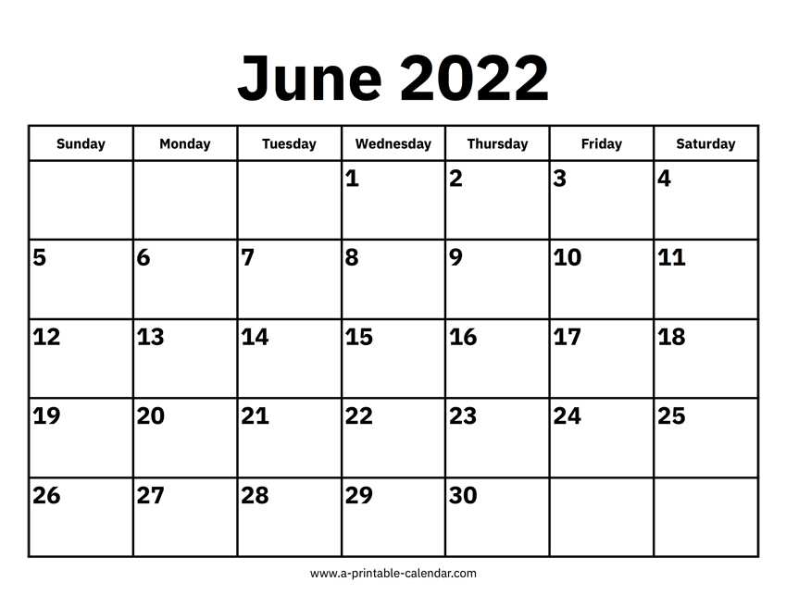
EdgeX Tech Talk Series 2022
May 24 - Getting Started with EdgeX
How to start your journey using EdgeX Foundry for your IoT/edge solutions
June 7 - Build an Application Service
Learn how to build a custom EdgeX application service using the EdgeX application functions SDK
June 14 - Build a Device Service
Learn how to build a custom EdgeX device service using the EdgeX device service SDKs
June 21 - Build a Device Profile
Device Profiles define sensors and devices for EdgeX.
Learning to write a device profile allows you to connect new sensors or devices to EdgeX without code
June 28 - Getting Started with Snaps
Presented by Canonical
Learn how to deploy and orchestrate EdgeX with snaps

Slide 4
Agenda
What is an EdgeX Device Service (Reminder)
EdgeX Device Profile Overview
Device Information
Device Resources
Device Commands
How to Create a Device Profile
Modbus power meter example
Creating a Modbus Device Profile
Onboarding the Modbus Device to EdgeX
Tooling to Simplify the Work: Device Configuration Tool (DCT)
Modbus example with DCT
EdgeX Ready program and Device Profile Verification
Further Assistance and Commercial Device Support from the EdgeX ecosystem
Where to learn more and get help
Q&A

Slide 5
EdgeX Device Service Reminder

Slide 6
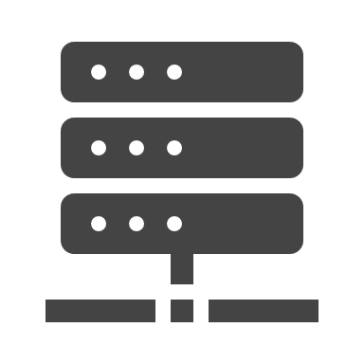





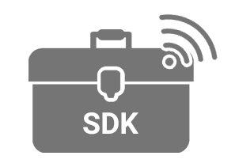










EdgeX Device Services
“Northbound” Cloud and IT infrastructure
System Management
Security Services
Application Services
Bi-Directional | Configurable Pipelines | Store & Forward | Filtering | Batching
SM Agent
Reverse Proxy
Supporting Services
eKuiper
(Rules Engine)
Scheduler
Alerts & Notifications
Additional Services
Additional Services
Additional Services
EdgeX UI (demo only)
Secret Store
Core Services
Core Data
Command
Meta Data
Registry & Config
CLI
Additional Security Services
Additional Security Services
Additional Security Services
Device Services
Virtual
REST
SNMP
CoAP
GPIO
Modbus
MQTT
Add’l
DS
Add’l
DS
Add’l
DS
“Southbound” OT Devices, Sensors, Cameras and Control Systems

Slide 7
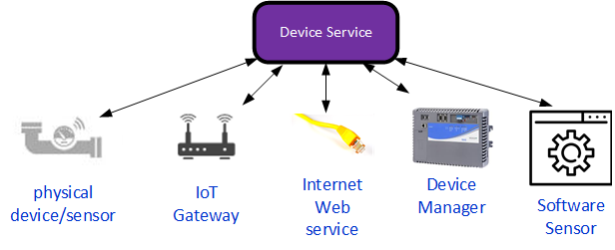
What is an EdgeX Device Service?
Connects the rest of EdgeX with a device or sensor
Typically, a physical sensor or device (a “thing” in IoT)
Examples: a vibration sensor, thermostat, camera, moisture sensor, …
Can be a virtual sensor or other system made to look like a sensor
Example: getting the weather from the Internet or data passed from another edge gateway
A device service speaks a particular protocol
Uses that protocol to communicate with the sensor/device
Example protocols: Modbus, BACnet, GPIO, MQTT, REST, BLE, …

Slide 8
Role of a Device Service
A device service has two (2) primary jobs
Get/collect sensor data from a sensor/device into EdgeX
Example: get the temperature and humidity readings from a thermostat
Set/actuate a device on behalf of EdgeX (or EdgeX’s user)
Example: set the thermostat’s cooling or heating point
A device service has other jobs too
Transform the sensor data into EdgeX formatted messages (normalizing)
Monitor the device/sensor (is the device still connected and functioning?)
Discover new sensors/devices and make them available to EdgeX
Automatic discovery is protocol dependent and referred to as “provisioning”

Slide 9



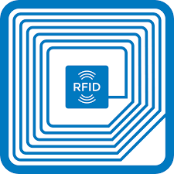



Existing Device Services
EdgeX comes with a number of device services that speak the popular IoT protocols
Modbus, BACnet, SNMP, MQTT, REST, GPIO, RFID/LLRP, ONVIF camera, USB camera, CoAP, Grove
Some written in Go and some in C
Language doesn’t matter because you typically don’t touch the code of the existing services
“Configure” these to get them to work with your sensor/device
Low or No code approach – saves integration effort
EdgeX even comes with a “virtual device” to simulate other sensors/devices
3rd party providers offer additional device services (typically commercially)
For proprietary protocols (ex: Profinet) and for more complete protocol implementation

Slide 10
EdgeX Device Profiles

Slide 11
Device Profile Overview
A Device Profile can be thought of as a template, type or classification of a Device
Provides general characteristics for the types of data a device sends and what types of commands or actions can be sent to the device
Includes 3 parts:
Device Information: identify the device - description, manufacturer, model, labels, etc
Device Resources: define the device characteristics or data points that the device has – for example a thermostat might record temperature, humidity, etc, and have a writable set point
Device Commands: how to command the device to get and set values
A device profile is described in YAML or JSON
Device Profiles and Devices are analogous to Class and Objects in software engineering terminology

Slide 12
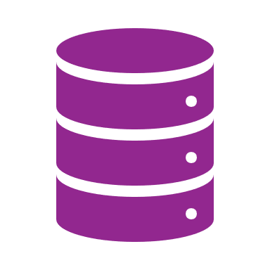
Big Picture Steps: Onboarding a Device
Add a device profile to Core Metadata so EdgeX knows the device content info
Add a device entity to Core Metadata so EdgeX knows the physical device info (IP address, Port, Baud Rate, etc)
The Core Metadata services notifies the Device Service a device has been created
The user can then execute read or write commands to access the real device
Device Service events are published to the internal EdgeX Message Bus so consumption by interested subscribers (App Service, Core Data, Supporting Services etc)
Core Services
Meta Data
Core Data
Command
Device Profile
Device
Device Services
Modbus
REST
MQTT

Slide 13
Device Information / Device Types
Identification Information. Not actually inspected by the device service
Device name
Device description
Device manufacturer
Device model
Device labels list that can be used when searching device profiles
name: ElsnerWeatherStation
description: Detecting light and temperature levels
manufacturer: Elsner
model: PO3-Modbus
labels:
- Weather
- LightLevel
- Temperature

Slide 14
Device Resources
A Device Resource specifies an individual value within a device that can be read or written to
The name and properties sections ensure that the modelling is protocol independent
Only the attributes section is Modbus (or BACnet, MQTT, OPC UA, etc) specific
The “isHidden” flag relates to the automatic creation of Core Commands for this resource (more later)
deviceResources:
-
name: Temperature
description: Current temperature detected by the sensor
isHidden: false
properties:
valueType: Uint16
readWrite: R
units: Degrees Celsius
attributes:
primaryTable: INPUT_REGISTERS
startingAddress: 1
Common Information
Protocol-Specific Information

Slide 15
Device Resources – Property Value Fields
Property Value Fields
Field | Mandatory (M) or Optional (O) | Description | Valid Values
valueType | M | The data type of the value | Bool, Int8 - Int64, Uint8 - Uint64, Float32, Float64, String, Binary, Object, Arrays
readWrite | M | Indicates whether the value is readable or writable | R, W, RW
units | O | Indicates the unit of the values: degrees, mm, percentages, etc | String
scale | O | Factor by which to multiply a reading before it is returned | Numeric
offset | O | Value to be added to a reading before it is returned | Numeric
base | O | Value to be raised to the power of the raw reading before it is returned | Numeric
mask | O | Binary mask applied to an integer reading | Numeric
shift | O | Number of bits to shift the integer reading to the right | Numeric
defaultValue | O | Value used for SET command which do not specify one | Numeric
minimum | O | Minimum value when setting | Numeric
maximum | O | Maximum value when setting | Numeric

Slide 16
Device Resources – Attribute Value Fields (for Modbus)
Attribute Value Fields
Field | Description | Valid Values
primaryTable | The data type of the value | HOLDING_REGISTERS INPUT_REGISTERS COILS DISCRETE_INPUT
startingAddress | The address in the Modbus device | Numeric
isByteSwap | The Modbus Device Service uses big-endian format. Defines whether to swap the byte on reading little-endian data to transform to big-endian format | Boolean
isWordSwap | Defines whether to use 16-bit segments, also known as words, to re-order the byte sequence with big-endian or little-endian formats | Boolean
rawtype | Optional. Defines the binary data read from the Modbus device and uses a value descriptor data type to identify the data type that the user wants to receive | String
stringRegisterSize | Optional. Used for defining the capacity of the device resource for String data | 1-123 inclusive

Slide 17
Device Commands (Optional)
Give control over the potential accessing of multiple Device Resources at the same time, either for logical or optimization reasons
(From previous slides) a Device Resource with “isHidden” false will automatically have a singular command generated for it that the Core Command Service is able to invoke (EdgeX V2 optimization to improve / simplify the profiles)
EdgeX Auto Events can invoke Device Commands on a repeating / periodic basis
Again, the “isHidden” flag relates to the automatic creation of commands available in Core Command Service
deviceCommands:
-
name: GetSensorValues
isHidden: false
readWrite: R
resourceOperations:
- deviceResource: Temperature
- deviceResource: LightLevel

Slide 18
Worked Example

Slide 19


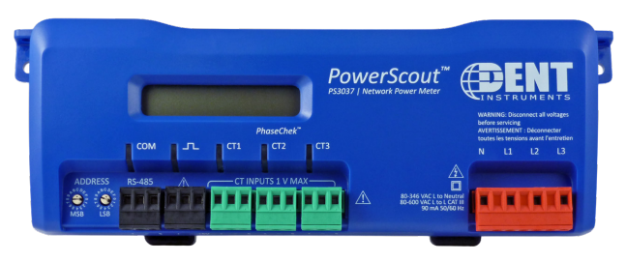
Modbus Power Meter
Datasheet: https://www.dentinstruments.com/wp-content/uploads/2021/04/PS3037-dent-datasheet-single-page.pdf
User Manual: https://www.dentinstruments.com/wp-content/uploads/2021/04/PS3037_Manual.pdf

Slide 20
Starting Out: Use a Base File and add Identify Information
If creating a new device profile, good to start with an existing file as a basis
wget https://docs.edgexfoundry.org/2.2/walk-through/EdgeX_CameraMonitorProfile.yml
First, define how we want to identity this device profile – name, description, etc
Reminder: meta data here not interpreted by EdgeX
name: Network-Power-Meter
manufacturer: Dent Instruments
description: Power Scout Meter
model: PS3037
labels: [modbus, powerscout]

Slide 21
What Sensor Values and Data Points Do We Want to Acquire?
The device’s user manual will tell you what values the device provides
Keep it simple and model only the relevant attributes
Noting that EdgeX 2.2 (Kamakura) just added support to add/edit/delete Device Resources to a Device Profile on-the-fly
For this power meter example, let’s focus on:
Current (amps)
Power (kWh)
Voltage (volts)
Energy (kW)
Demand Window Size (minutes) 15 by default
Line Frequency (hz) 50 or 60
These will all be Device Resources in our Device Profile

Slide 22
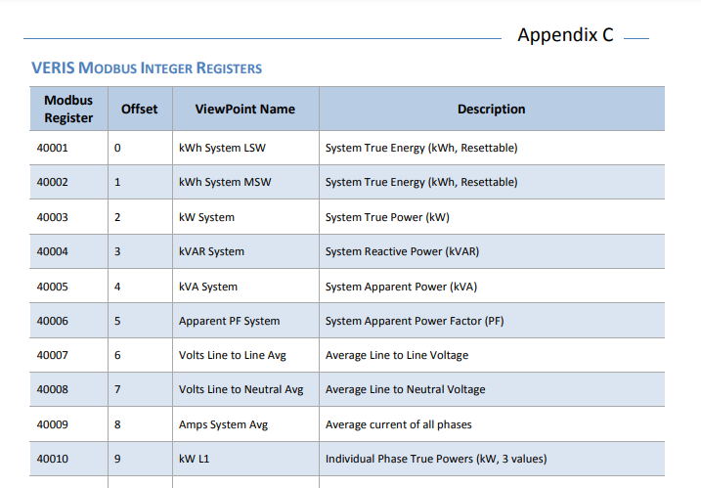

Accessing the Current Value
name: Current
description: Average current of all phases
isHidden: false
properties:
valueType: Uint16
readWrite: R
units: amps
attributes:
primaryTable: HOLDING_REGISTERS
startingAddress: 8
Holding Registers start at 40000 and Modbus addressing is zero based, so 40009 equates to a Modbus startingAddress value of 8 in our Device Resource
We know it’s a single word with standard unsigned 16 bit integer addressing

Slide 23
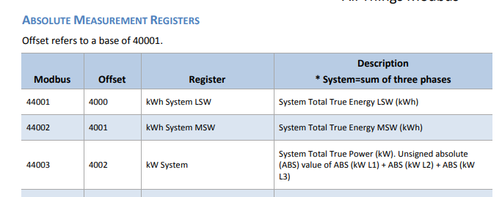
Accessing the Energy Value
name: Energy
description: System Total True Energy
isHidden: false
properties:
valueType: Float32
readWrite: R
units: kWh
attributes:
primaryTable: HOLDING_REGISTERS
startingAddress: 4000
Holding Registers start at 40000 and Modbus addressing is zero based, so 44001 equates to a Modbus startingAddress value of 4000 in our profile
Energy here spans two registers – Least Significant Word (LSW) and Most Significant Word (MSW). This can be read as a single Float32 value

Slide 24
Do we want to access multiple values at a time?
The data is largely in two categories with perhaps different requirements in terms of data collection:
Current (amps)
Power (kWh)
Voltage (volts)
Energy (kW)
Demand Window Size (minutes)
Line Frequency (hz)
These will be Device Commands in our Device Profile
Values, regular periodic measurement data, read-only
Configuration, only occasionally changing,
read and writable

Slide 25
Accessing the Values and Configuration
deviceCommands:
- name: Values
isHidden: false
readWrite: R
resourceOperations:
- deviceResource: Current
- deviceResource: Energy
- deviceResource: Power
- deviceResource: Voltage
- name: Configuration
isHidden: false
readWrite: RW
resourceOperations:
- deviceResource: DemandWindowSize
- deviceResource: LineFrequency
The Device Service may choose to optimize accessing these device resources (implementation and protocol dependent)

Slide 26
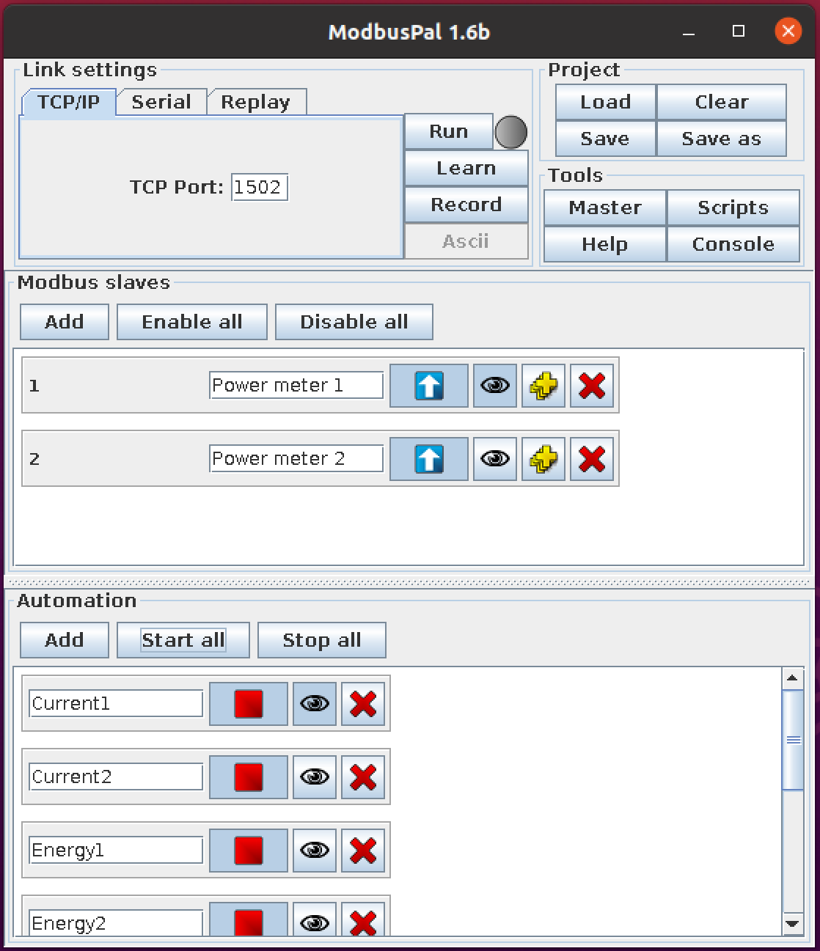
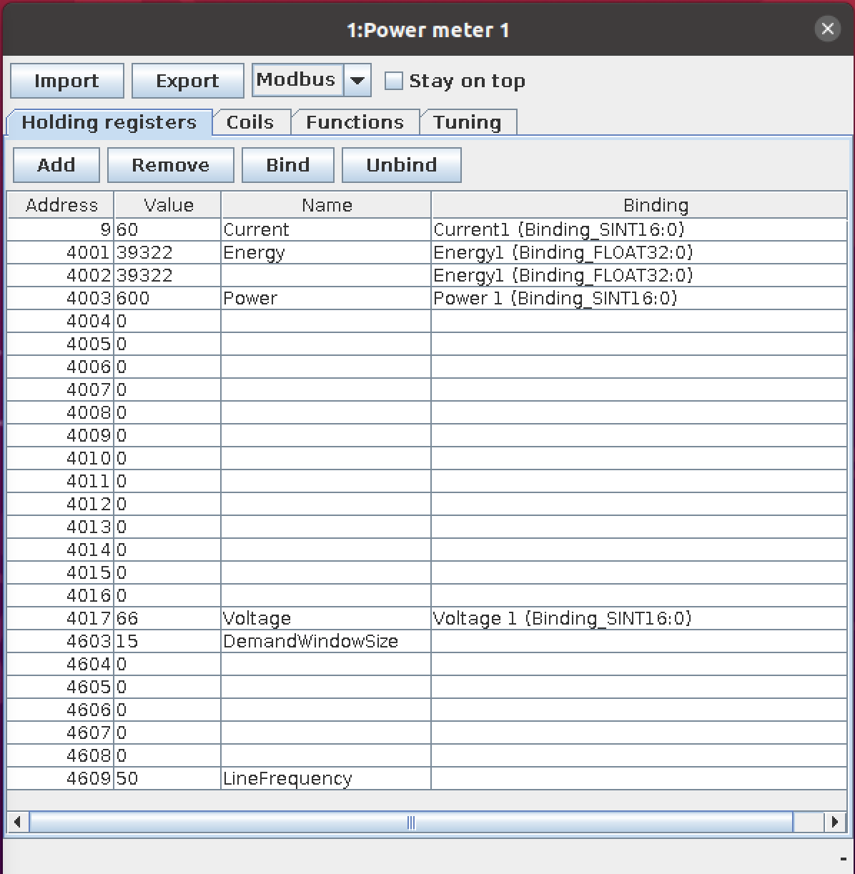
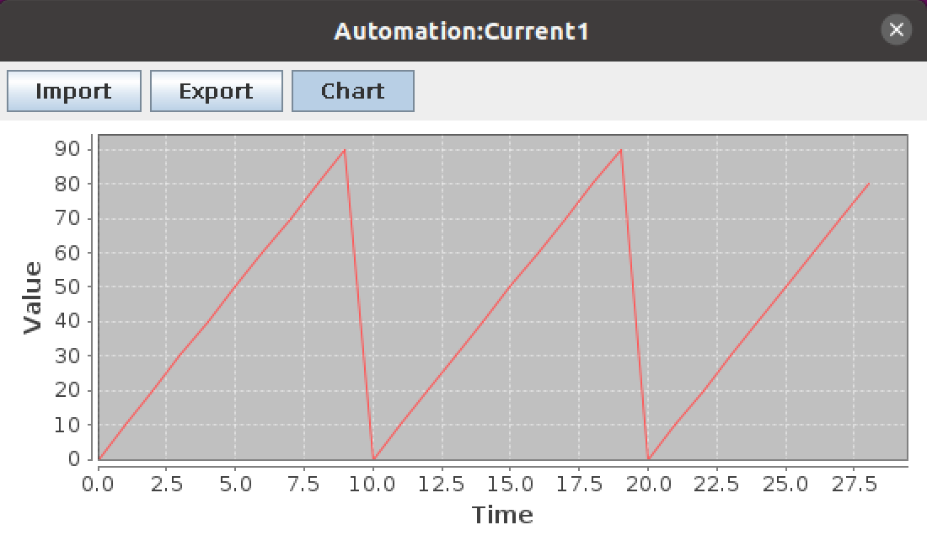
Running the Example
Use the real device or a Modbus simulator programmed with the correct registers

Slide 27
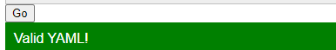
Running the Example
curl http://localhost:59881/api/v2/deviceprofile/uploadfile -F file=@/home/james/EdgeX/PowerMeter.yaml
curl http://localhost:59881/api/v2/device -H "Content-Type:application/json" -X POST \
-d '[
{
"apiVersion": "v2",
"device": {
"name": "Power-Submeter-Device",
"description":"Power Submeter device",
"labels":[
"power submeter",
"modbus TCP"
],
"adminState": "UNLOCKED",
"operatingState": "UP",
"protocols": {
"modbus-tcp": {
"Address": "172.17.0.1",
"Port": "1502",
"UnitID": "1",
"Timeout" : "5",
"IdleTimeout" : "5"
}
},
"serviceName": "device-modbus",
"protocolName":"modbus-tcp",
"profileName": "Network-Power-Meter",
"autoEvents": [
{
"interval": “60s",
"onChange": false,
"sourceName": "Configuration"
},
{
"interval": "5s",
"onChange": false,
"sourceName": "Values"
}
]
}
}
]'
I used edgex-compose with Modbus to generate a docker-compose.yml
Tip: verify the yaml file is valid
http://www.yamllint.com/

Slide 28
Ease-of-Use with Tooling
IOTech Device Configuration Tool (DCT)

Slide 29
Why do we need Tooling for this?
Potential issues with the manual approach:
Requires a specific knowledge of the syntax
Typos and copy / paste errors
Syntactic errors
Updating all references
Benefits of tooling
Can greatly simplify the effort involved, saving time and money
Helps eliminate typos and syntactic errors
Abstract the technicalities of YAML and JSON into intuitive GUI format
No longer just for software engineers

Slide 30
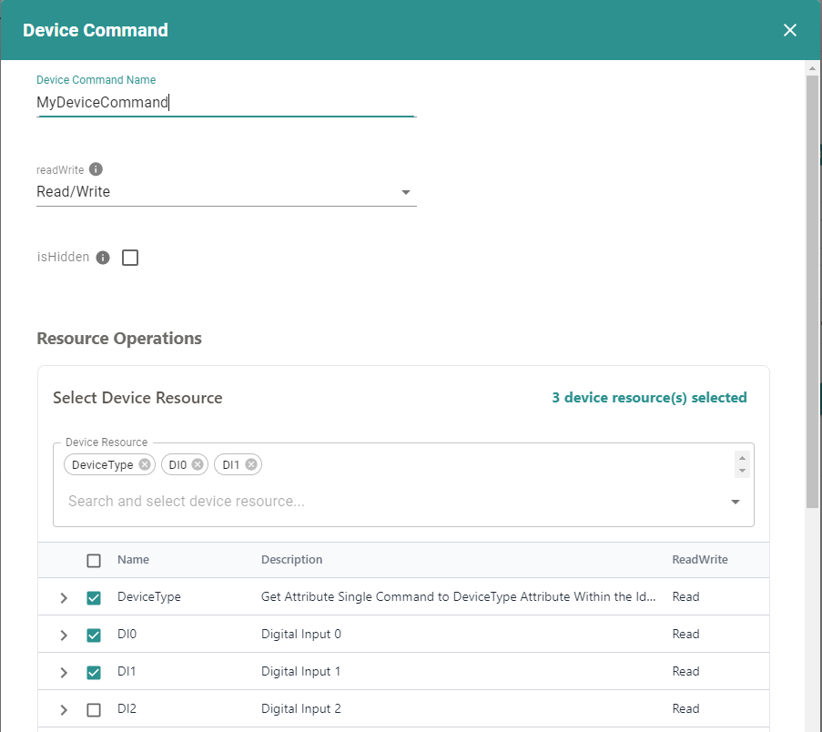
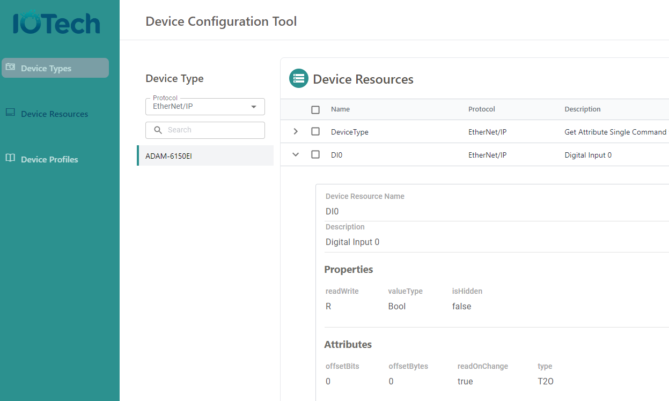
Device Configuration Tool (DCT)
Signup at https://dct.iotechsys.com
Commercial IOTech tool but free for EdgeX users!

Slide 31
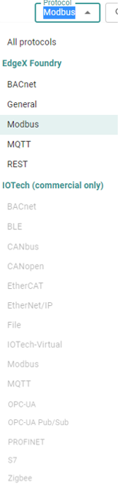
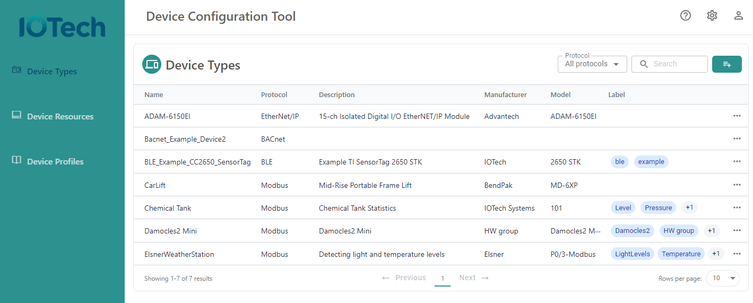
DCT Step 1: Create a Device Type
Create a new Device Type. Choose the protocol:

Slide 32
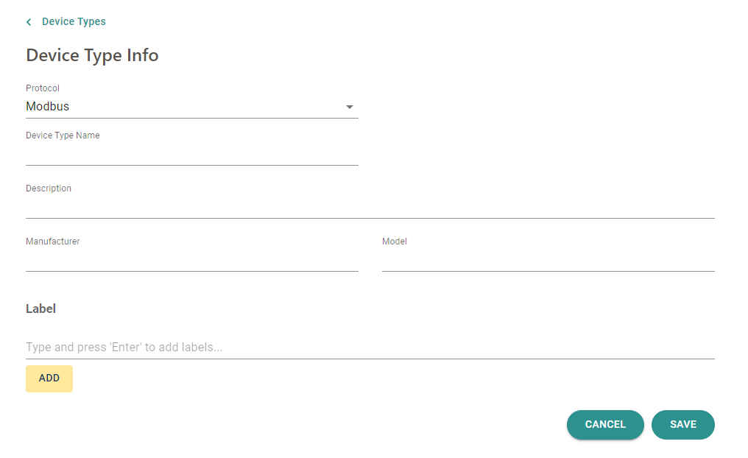
DCT Step 1: Create a Device Type

Slide 33
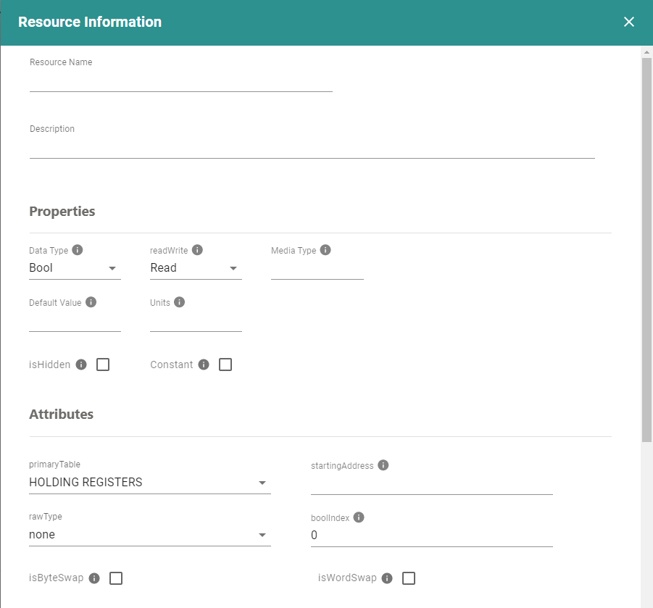
DCT Step 2: Create a Device Resource
Pick an existing Device Type, and click add new Device Resource
The attributes are protocol specific and based on the Device Type (Modbus in this case):

Slide 34
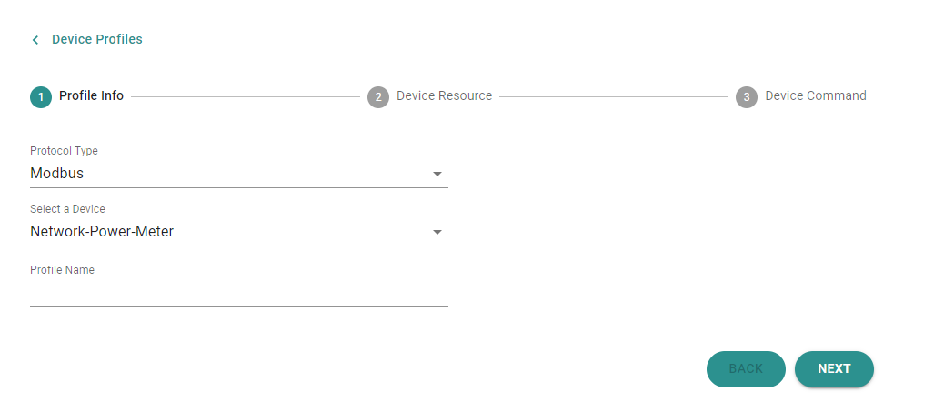
DCT Step 3: Create the Device Profile
Pick an existing Device Type, and give the new Device Profile a name
Note that a single Device Type can have multiple Device Profiles (i.e. different combinations of Device Resources that you want to expose)

Slide 35
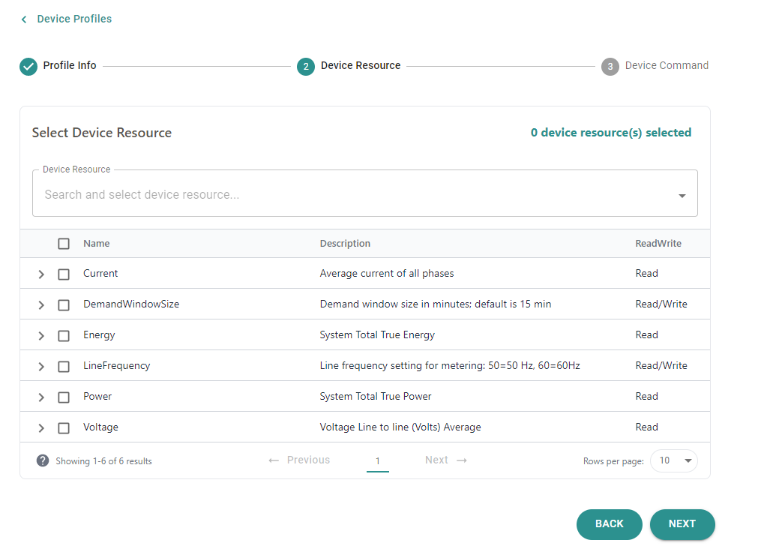
DCT Step 3: Create the Device Profile
Select which Device Resources are needed in this specific Device Profile

Slide 36
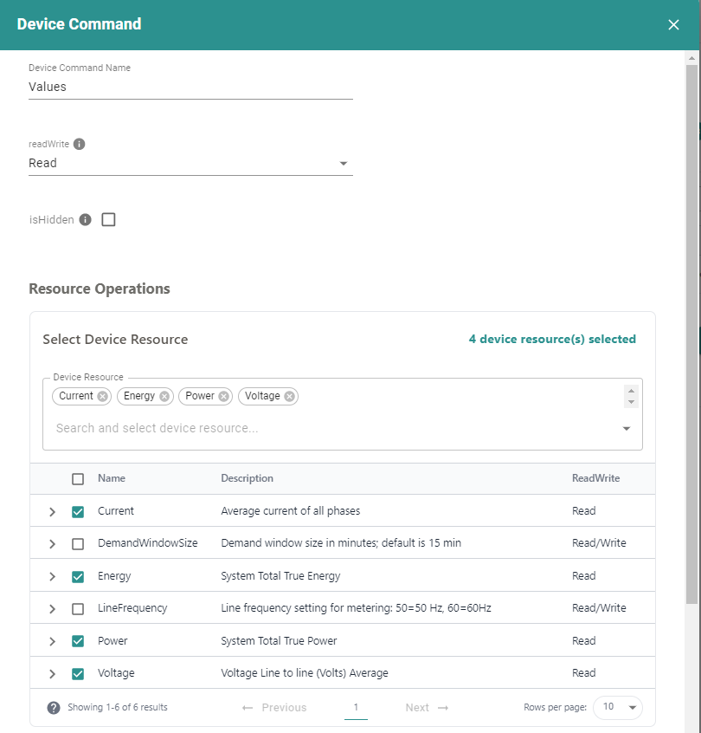
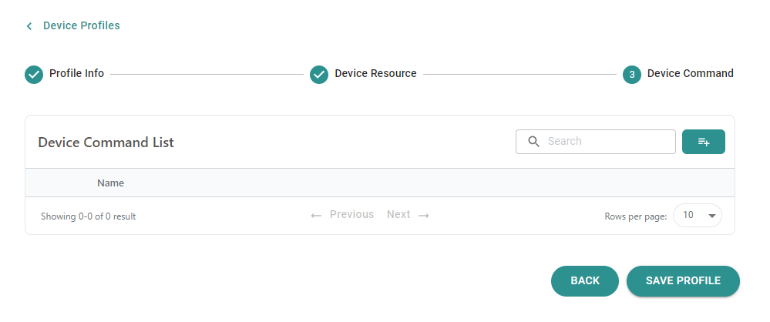
DCT Step 3: Create the Device Profile
Select the make up of any Device Commands – which Device Resources do we want to get/set together

Slide 37
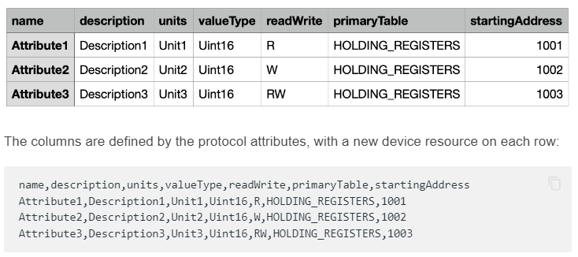
DCT : Other Time-Saving Features
Import existing Device Profiles into the DCT
Export as V1 or V2, in YAML or JSON formats (Great for migrating between EdgeX versions)
Export in other formats – e.g., Digital Twin Definition Language
Import Device Resources in CSV file format – many device manufacturers can provide this information which can help reduce time and effort even further

Slide 38

The EdgeX Ready Program
Highlights the ability of EdgeX users and adopters to work with EdgeX
You earn your EdgeX Ready designation by going through a self-assessment process
Today, the self-assessment process requires an EdgeX adopter to:
Get and run an instance of EdgeX and associated services
Create and validate a device profile that represents their device
Use the profile with an EdgeX device service to provision a device and send sensor data into EdgeX
DCT performs the role of validating Device Profile syntax
Submit your materials (participation form, device profiles, sample sensor data) to the Certification Group
https://wiki.edgexfoundry.org/display/FA/EdgeX+Ready

Slide 39
Going Further
More Assistance and Commercial Device Connectivity

Slide 40














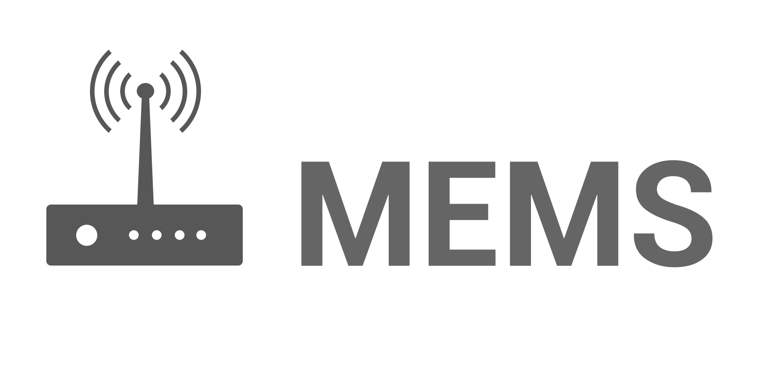



IOTech / Edge Xpert Provides Commercial Device Connectivity for EdgeX
Based on EdgeX Device Services but enhanced, productized and ruggedized for industrial use
Additional features e.g., automatic discovery where possible
Performance upgrades
Robust and deployment-ready
Most not available in open source
Can be used with EdgeX or Edge Xpert

Slide 41
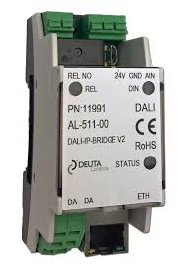
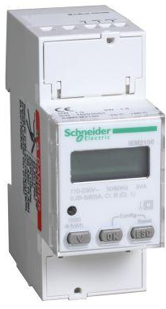
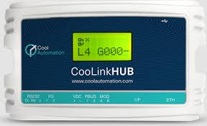
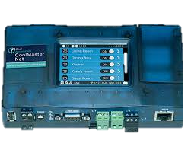
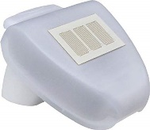

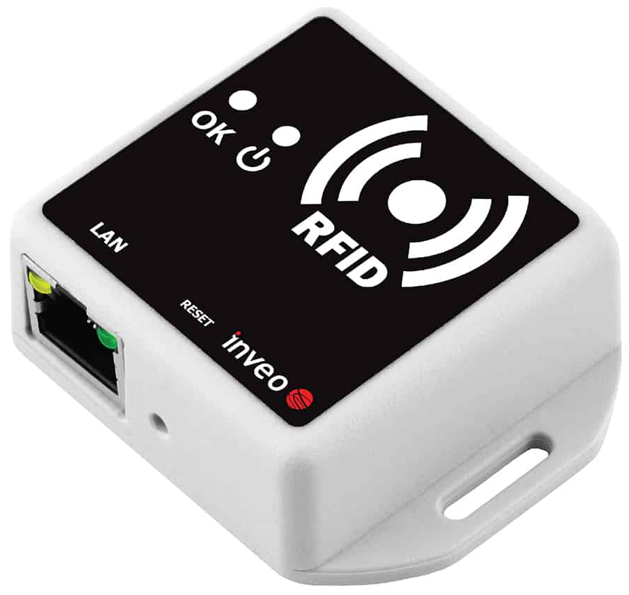
Edge Xpert Value-Add: Modbus
Prevalent in Industrial Automation and Buildings Management
Available in EdgeX Foundry as open source Device Service
IOTech Value-Add
Device Service is re-implemented in C (compared to Go-Lang EdgeX version):
Faster Read/Write Access
Better scalability
Reduced Footprint
Batch (multi) read and write operations for faster data rates
Supports more devices, e.g., requiring byte & word swapping on all Modbus types
Tested and deployed on wide variety of real Modbus devices
IOTech technical support and expertise

Slide 42
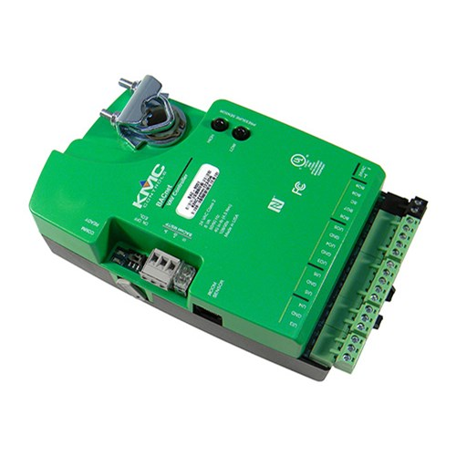
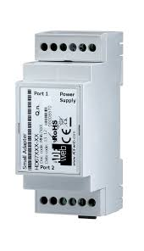
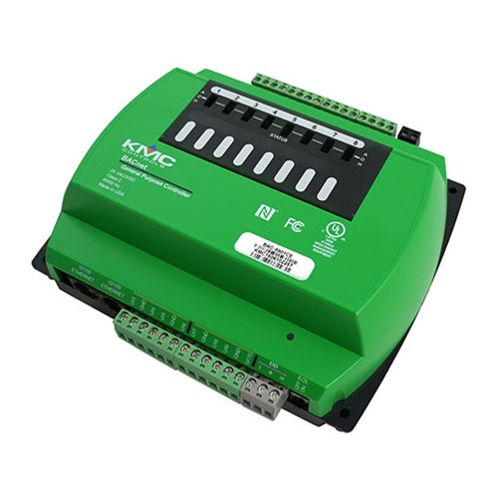
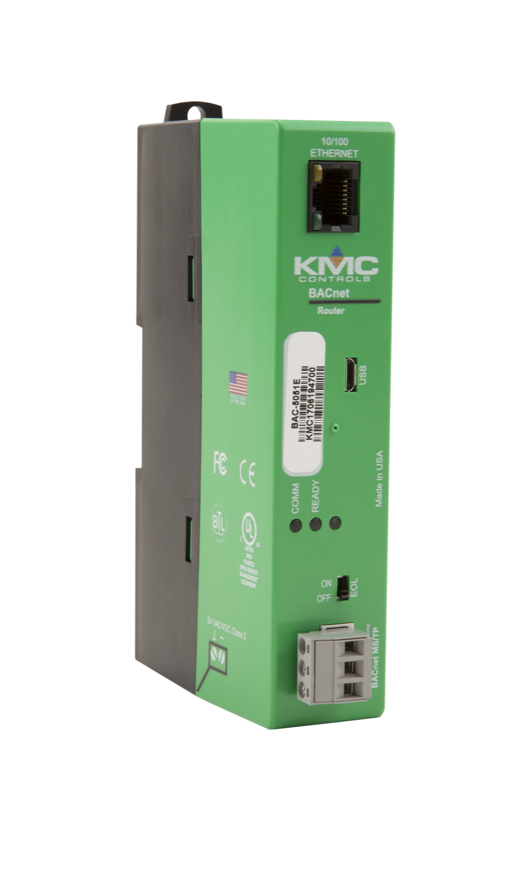
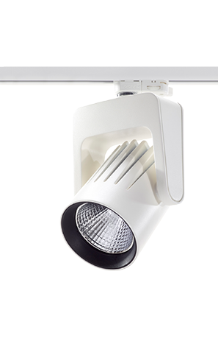
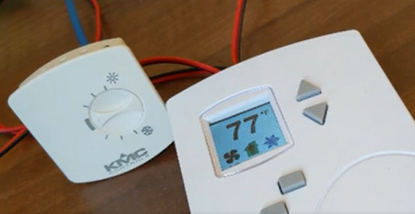
Edge Xpert Value-Add: BACnet
Prevalent in COTS devices in HVAC, access control and safety
Available in EdgeX Foundry as open source Device Service
IOTech Value-Add
Automatic discovery (don’t need to create device profiles) and onboarding of devices
Batch/multi read and write operations for faster data rates
Supports more devices via additional types and objects
Supports BACnet Change of Value (COV) for subscription-based updates
Tested and deployed on wide variety of real BACnet devices
IOTech technical support and expertise

Slide 43
Resources
Docs
docs.edgexfoundry.org
https://docs.edgexfoundry.org/2.2/microservices/device/profile/Ch-DeviceProfile/
https://docs.edgexfoundry.org/2.2/examples/Ch-ExamplesAddingModbusDevice/
Device Configuration Tool (Free for EdgeX Users)
https://dct.iotechsys.com
Slack
edgexfoundry.slack.com (#device-services channel)
EdgeX YouTube Channel
www.youtube.com/channel/UC30DbbsoqbkGJYJ5omJJsng
Social Media
Email Forum  https://lists.edgexfoundry.org/mailman/listinfo
Twitter  https://twitter.com/EdgeXFoundry
LinkedIn  https://www.linkedin.com/company/edgexfoundry/

Slide 44
EdgeX Tech Talk Series 2022 Reminder – Come back and see us
May 31 - Getting Started with EdgeX
How to start your journey using EdgeX Foundry for your IoT/edge solutions
June 7 - Build an Application Service
Learn how to build a custom EdgeX application service using the EdgeX application functions SDK
June 14 - Build a Device Service
Learn how to build a custom EdgeX device service using the EdgeX device service SDKs
June 21 - Build a Device Profile
Device Profiles define sensors and devices for EdgeX.
Learning to write a device profile allows you to connect new sensors or devices to EdgeX without code
June 28 - Getting Started with Snaps
Presented by Canonical
Learn how to deploy and orchestrate EdgeX with snaps

Slide 45
Tech Talk Feedback
Q&A
Tech Talk Feedback
Let us know how we did
Let us know what other topics you’d like to see
Email:
info@edgexfoundry.org
james@iotechsys.com

